Slide 1
2022 IIS Summer Internship: Data Science
Poojyatha Venkatesh

Slide 2
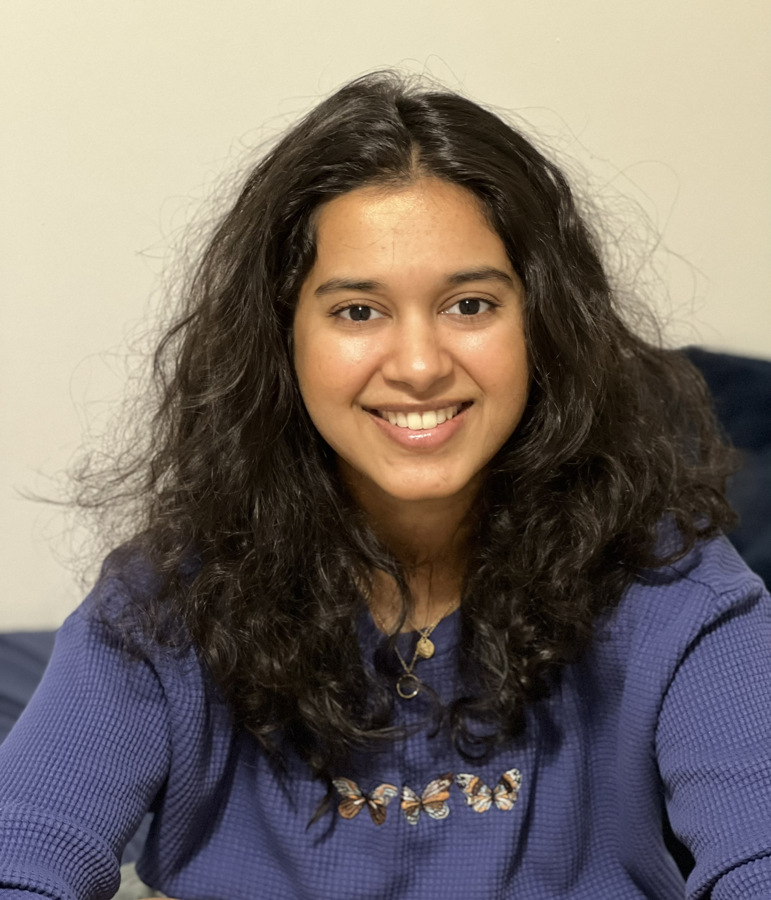
About Me
MS – Applied Data Science, IUPUI
Bachelor’s - Information Technology, Anna University, Chennai, India
Internship - Enterprise Analytics Team, Clinical Research Department
Fun fact about me– I make and sell Indian Kerala Mural paintings and I am trained in Indian Classical Music for several years

Slide 3

IU Health Values
Excellence: Strived to go above and beyond to solve problems for customers and the team
Team: Collaborated with various team members to complete tasks and initiatives
Purpose: Supported all relevant stakeholders by providing effective solutions for problems and initiatives

Slide 4
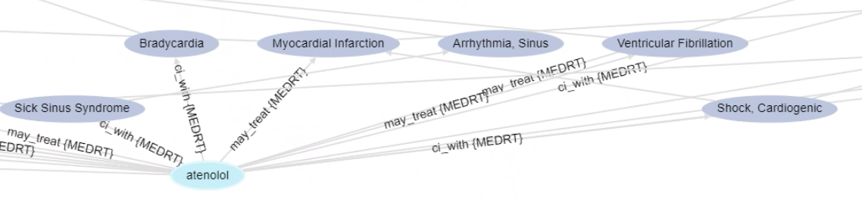
Purpose
Understand the relationship between drugs and health outcomes through RxNorm Concept Types (CTY)
Concept indicates a criteria (like Method of Action[MoA], Pharmokinetics [PK], etc) used to describe drugs
When we connect drugs through concepts, we can understand how they are used in the treatment of diseases
Patient cohorts can be identified based on characteristics of medications

Slide 5
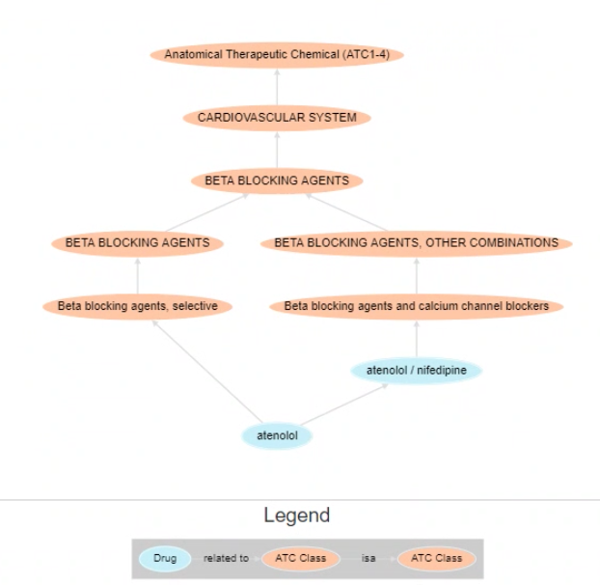
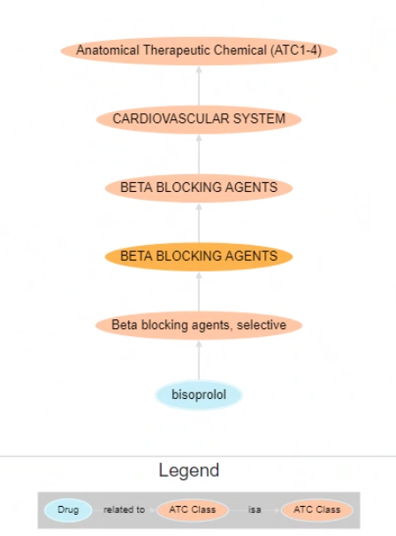
Example of 2 similar drugs under the same Concept Type - ATC

Slide 6
Description
My role : Identify relationships between drugs and diseases and show characteristics of drugs including how they work
Clinical Research Department :
Operation of Clinical Trials in Cerner (managing Protocol and Subject information, building Pre-screening to identify trial candidates, building Order sets for research protocols)
Feasibility evaluation, identification of patient cohorts for both retrospective and prospective clinical research, data extraction and analysis as well as development of ML models for research
Design and development of Cohort identification and analysis tool
Healthcare IS before / after : Instead of associating drugs with diseases, we delve deeper and make searches more complex through including more facets into hierarchy like pharmacological class, concept types, etc. Correlation of drug regimens to diseases and health outcomes.

Slide 7
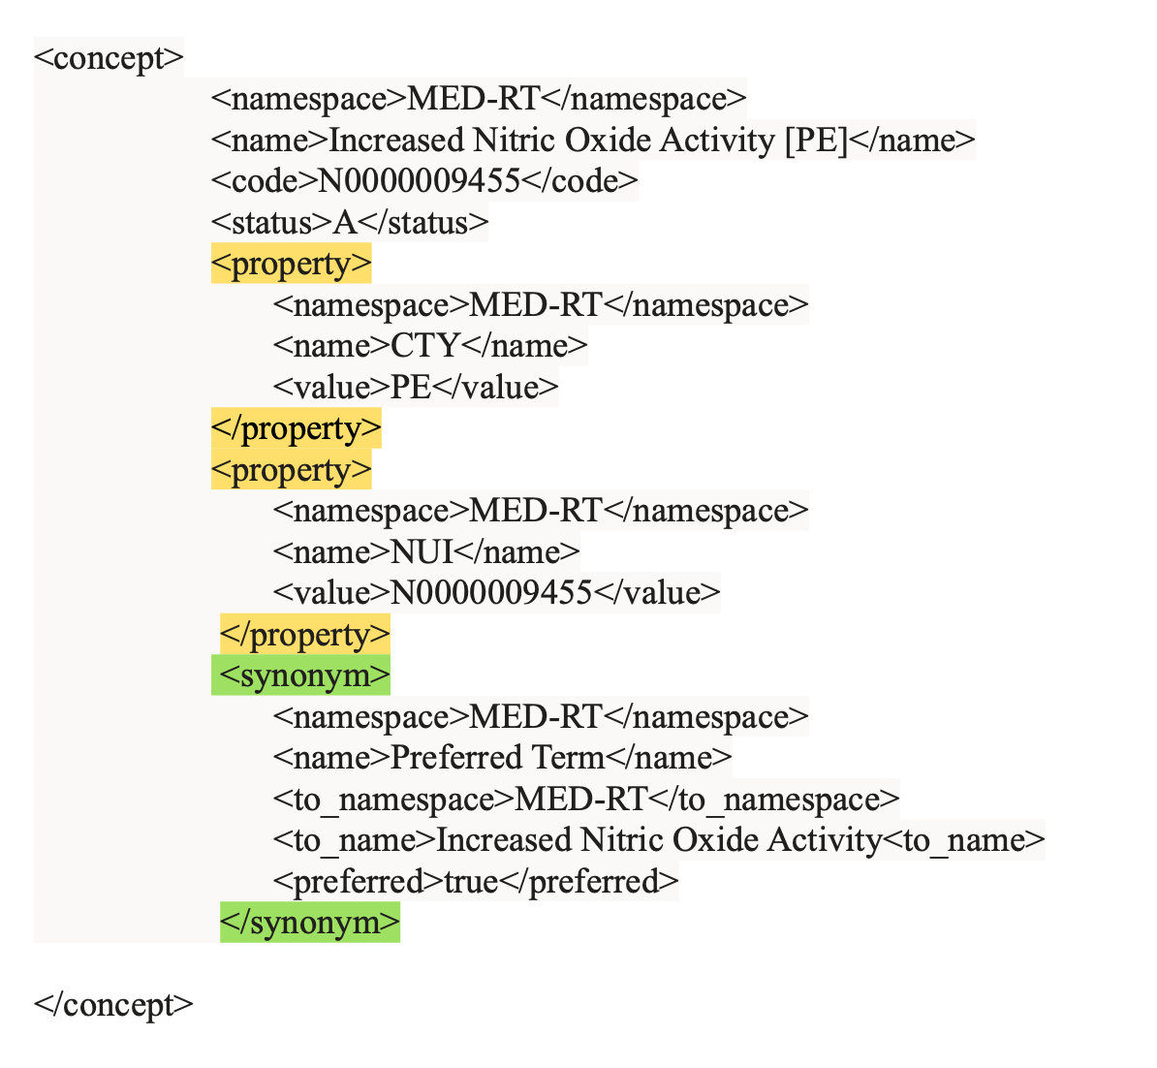

Project
Transform xml files with complex structures to flat formats with fields and rows through data manipulation
Analyze these created tables and explore if there are commonalities between these newly formed data related to drugs (from xml format) and the data related to patients in EDW Cerner
Combine these data be creating crosswalks between both the sets of data
Could group drugs based on certain criteria like Concept Types

Slide 8
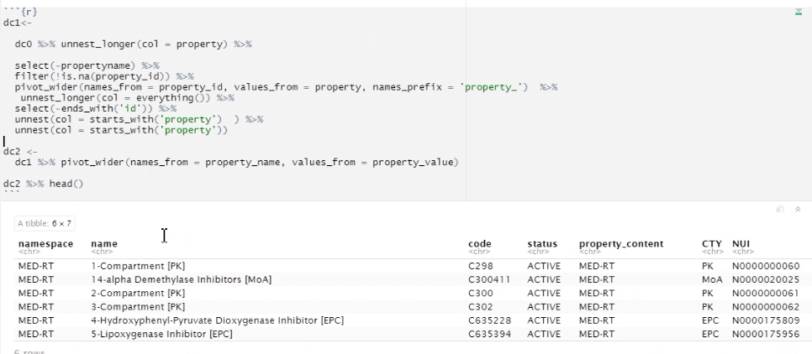
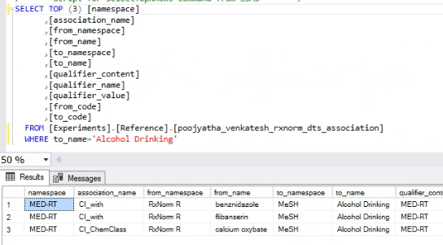
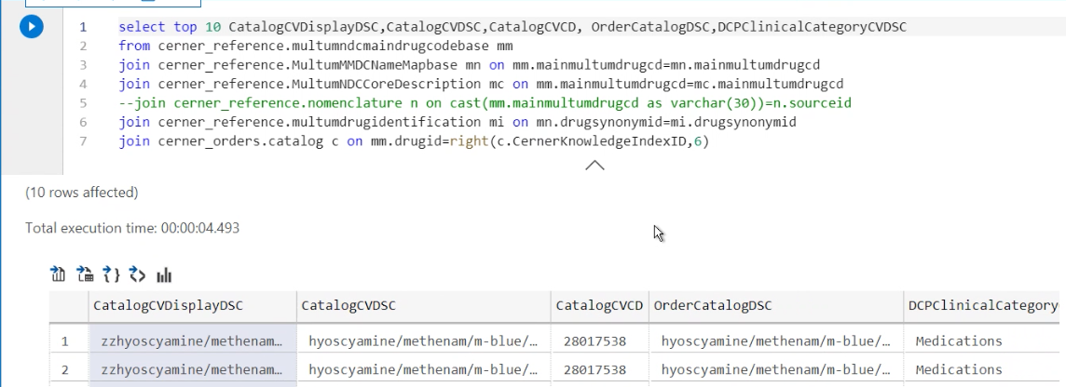
Data manipulation from xml to tables
Grouping of Drugs
Patient data from Cerner

Slide 9
Goals and Accomplishments
Was successful in bringing RxNorm drug nomenclature data to the Cerner Data Source mart
Was successful in finding commonalities between the data related to drugs and patient data
Better knowledge on the classification of drugs used to study disease progression and health outcomes

Slide 10
Recommendations and improvements
Productionize so that it can be run every month – RxNorm updates the drug data everymonth. A code that automates the job of downloading the latest drug data from RxNorm, parse the xml files and stage them into Cerner Data Source Mart
Use the ontologies to correlate treatments with health outcomes

Slide 11
Thank you!

